Slide 1
EENG 385 LTspice
Notes:
Usually the <title of the lab> is what will be called the “System” through the rest of this document

Slide 2
Lab Instructor Bio
Introduce yourself to the class.
Where is your hometown?
Family?
Pets?
What sorts of activities do you enjoy?
What sorts of unique life experiences would you like to share?
Pictures, pictures, pictures.

Slide 3
Lab Objectives
Use Ltspice to assemble two schematics and generate waveforms for the signals in the schematic and measure characteristics of the waveforms using cursors.

Slide 4
Installing LTspice
Very helpful for personal use
Straight forward
Customizing tips provided
Notes:
Replace <System> with the name of the

Slide 5
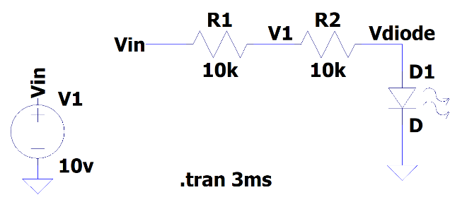
Building a schematic
All labs will provide a schematic drawn in Ltspice
Wires are called “Nets”
Same net name creates connections
You can change
Location of components
Orientation of components
You should not change
Value of components
Connections of components
Notes:
Replace <System> with the name of the

Slide 6
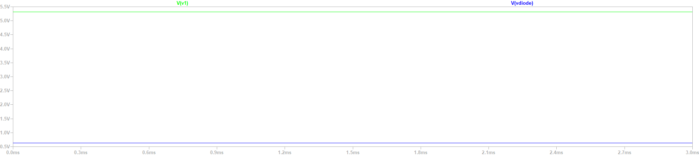
Running a simulation
You are performing transient simulations
Add probes to schematic to add traces in waveform window
Notes:
Replace <System> with the name of the

Slide 7
Extras
Generating periodic signal generators
Measuring waveform characteristics using cursors

Slide 8
Turn In
Answer listed questions at end of lab
Save solutions as PDF
Due before start of lab next week
This is an individual lab

